Slide 1



Vision-Based Emotion Detection of Gameplayers – ERS (Emotion Recognition System)
a final year project by Shavin croos
20 MAY 2022

Slide 2
Overview
Background
Research
Methodology
Demo
Experimentation Results
Conclusion

Slide 3

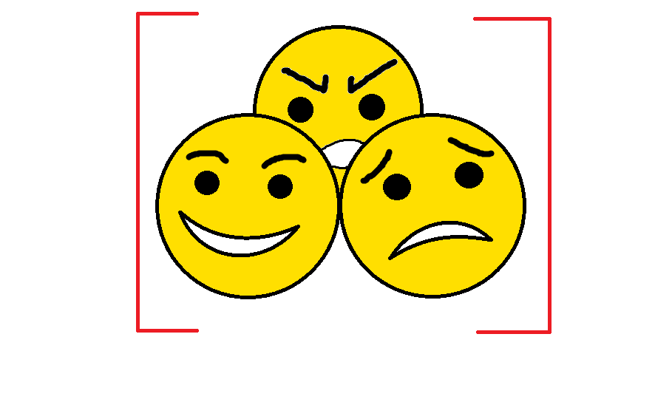
Background

Slide 4


Background
Gaming has been around for the last 50 years since its inception in the 1970s ^{[1]}.
Since then, the demand for games and gaming has increased, especially during the lockdown period.
Statistica ^{[2]} showed that there was a total increase in game sales of 63% between 16th – 22nd March 2020, equating to 4.3 million games being sold worldwide.
Despite consumers enjoying the games they play, they don’t see the effect of the gameplay on their emotions, which makes designing games more difficult.
[1] Wikipedia. (2022, April 14). Video game. Wikipedia. Retrieved 18 April 2022, from https://en.wikipedia.org/wiki/Video_game
[2] Statista, & Clement, J. (2021, January 29). COVID-19: global video game sales increase as of March 2020. Statista. Retrieved 18 April 2022, from https://www.statista.com/statistics/1109977/video-game-sales-covid/#professional

Slide 5

Research
There have been other studies that have shown that there is a link between the gameplay and emotions.
However, the methods that these studies employ to capture the emotions different and did not focus much on facial emotions, but the psychological emotions.
In addition to this, none of the studies researched considered gameplay time as a key factor in the experiments they conducted.

Slide 6

Research
Non-specialised, generic-purpose language which can be used to create a range of different programs.
Can handle statistical data better than other programming languages.
Very versatile and easy to use.
Has vast libraries and modules support.

Slide 7

Research
“A hybrid face recognition framework that uses state-of-the-art models for analysis such as VGG-Face, Google Facenet, Facebook Deepface, all wrapped together in one.” [3]
“The accuracy of identification goes up to 97% and has proven to be more efficient in detecting faces than other average face recognition frameworks.” [3]
Its easier to implement and use when compared to other face recognition frameworks.
[3] Dey, V. (2021, October 13). Face Recognition System using DEEPFACE (With Python Codes). Analytics India Magazine. Retrieved 12 April 2022, from https://analyticsindiamag.com/face-recognition-system-using-deepfacewith-python-codes/

Slide 8
Methodology
Initialising of the Program, the Camera and
Front Face Classifier
Drawing Rectangle of Detected Face and Mapping Emotions
OpenCV
CVZone (used for SelfiSegmentation class)
Tkinter
DeepFace
Warnings Based Off Anger and Happy Emotions & Termination of Program
Creating the Main Menu of the program

Slide 9
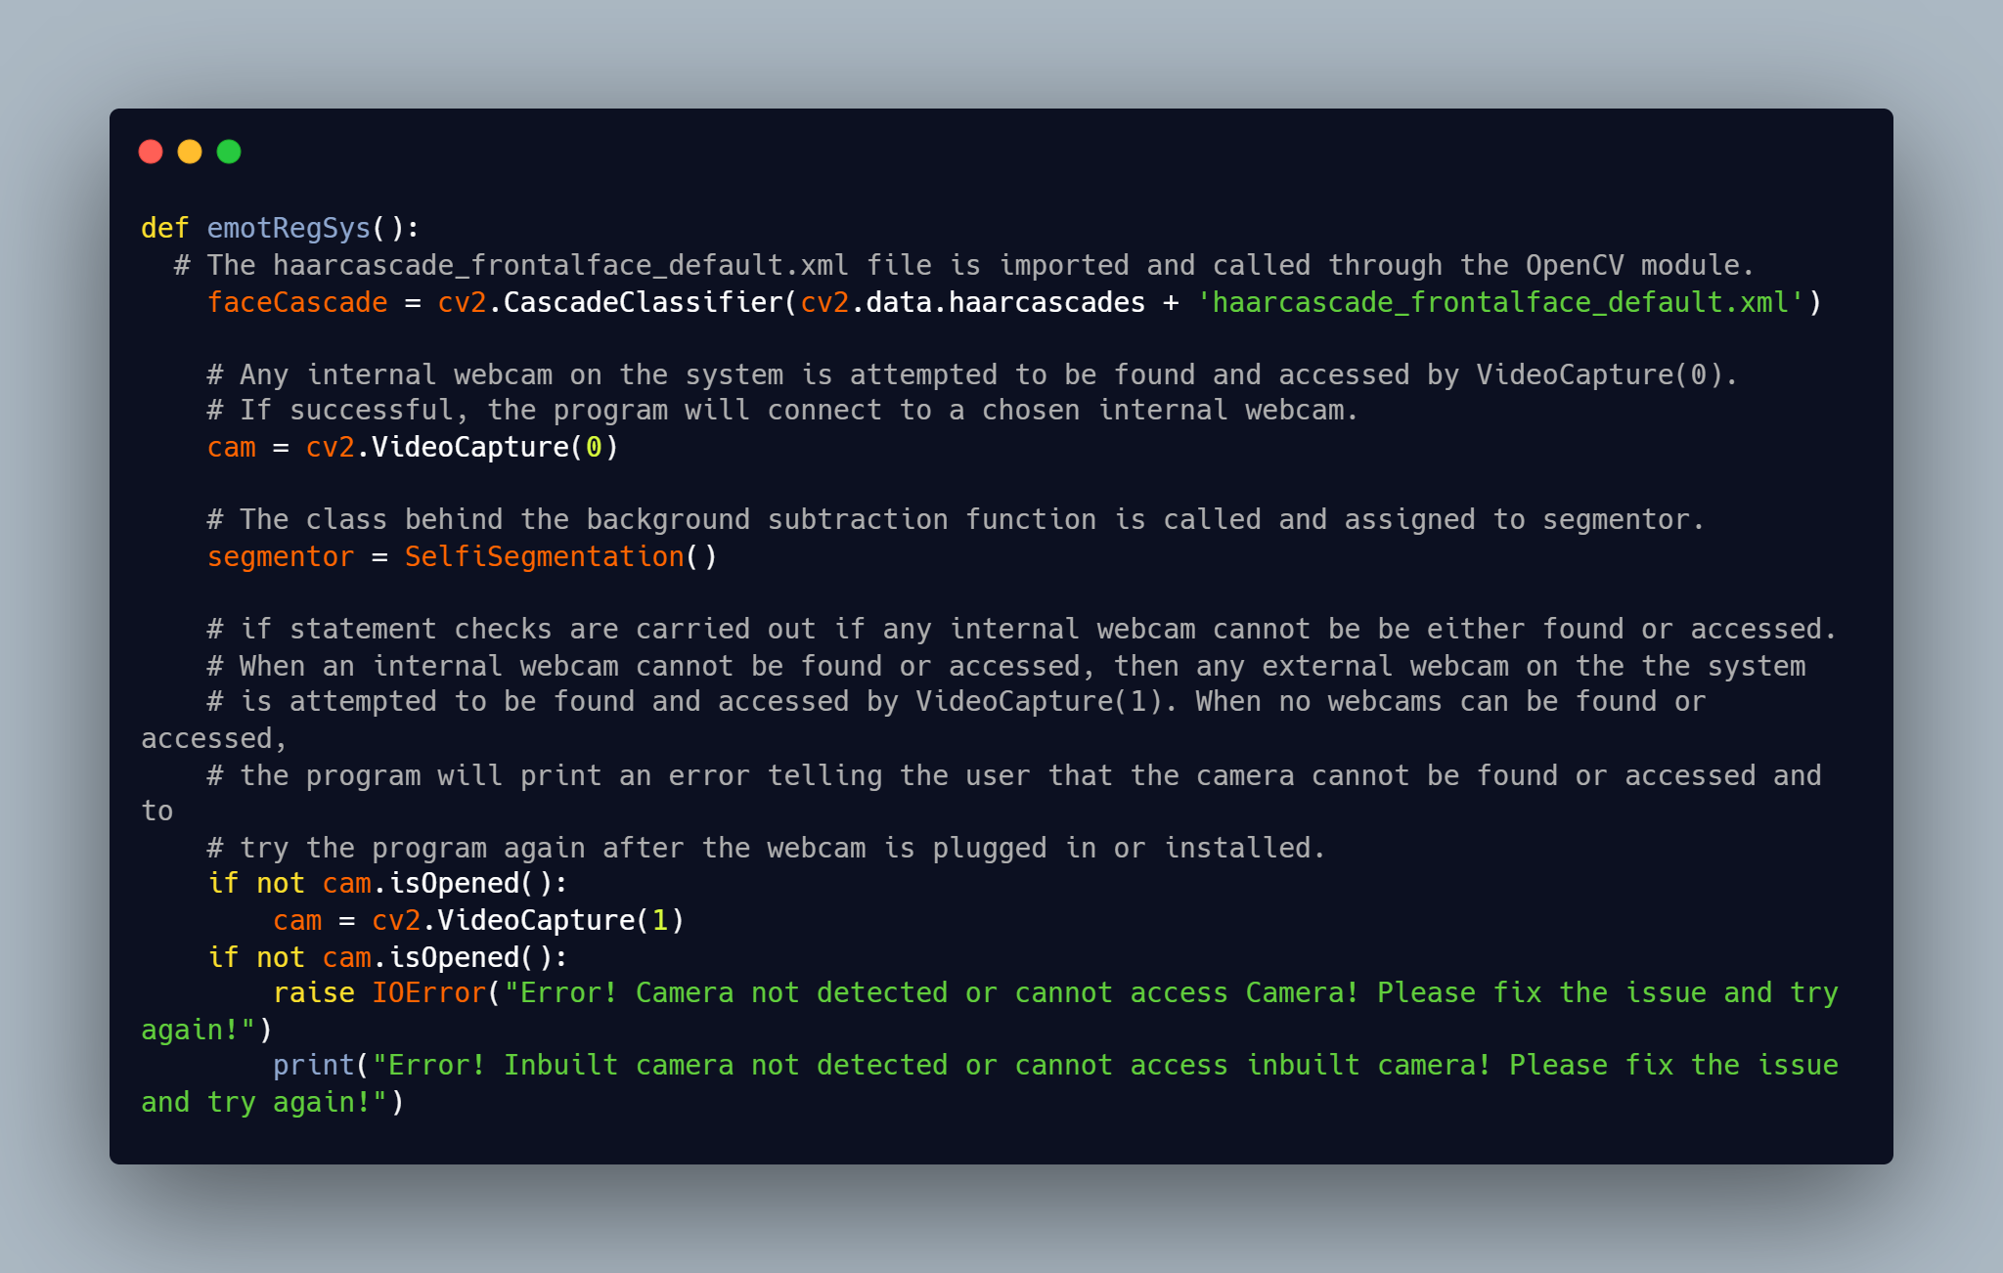
Initialising of the Program, the Camera and Front Face Classifier

Slide 10
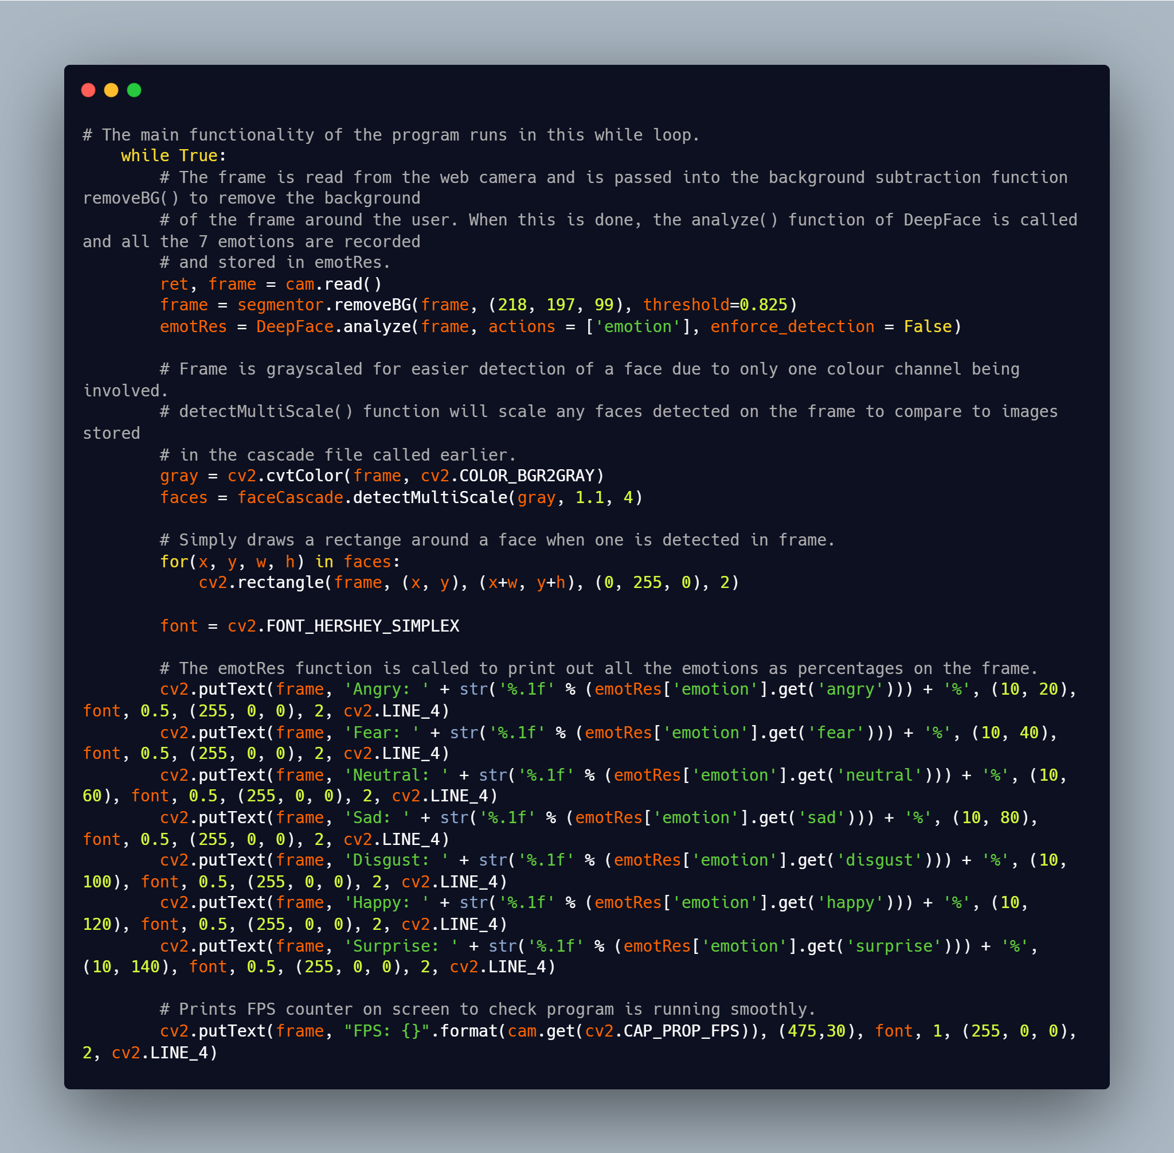
Drawing Rectangle on Detected Face and Mapping Emotions

Slide 11
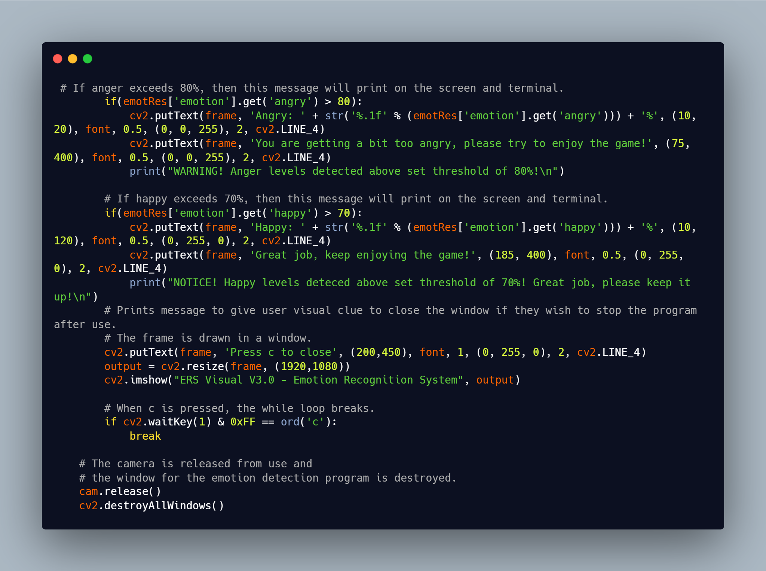
Warnings Based Off Anger and Happy Emotions & Termination of Program

Slide 12
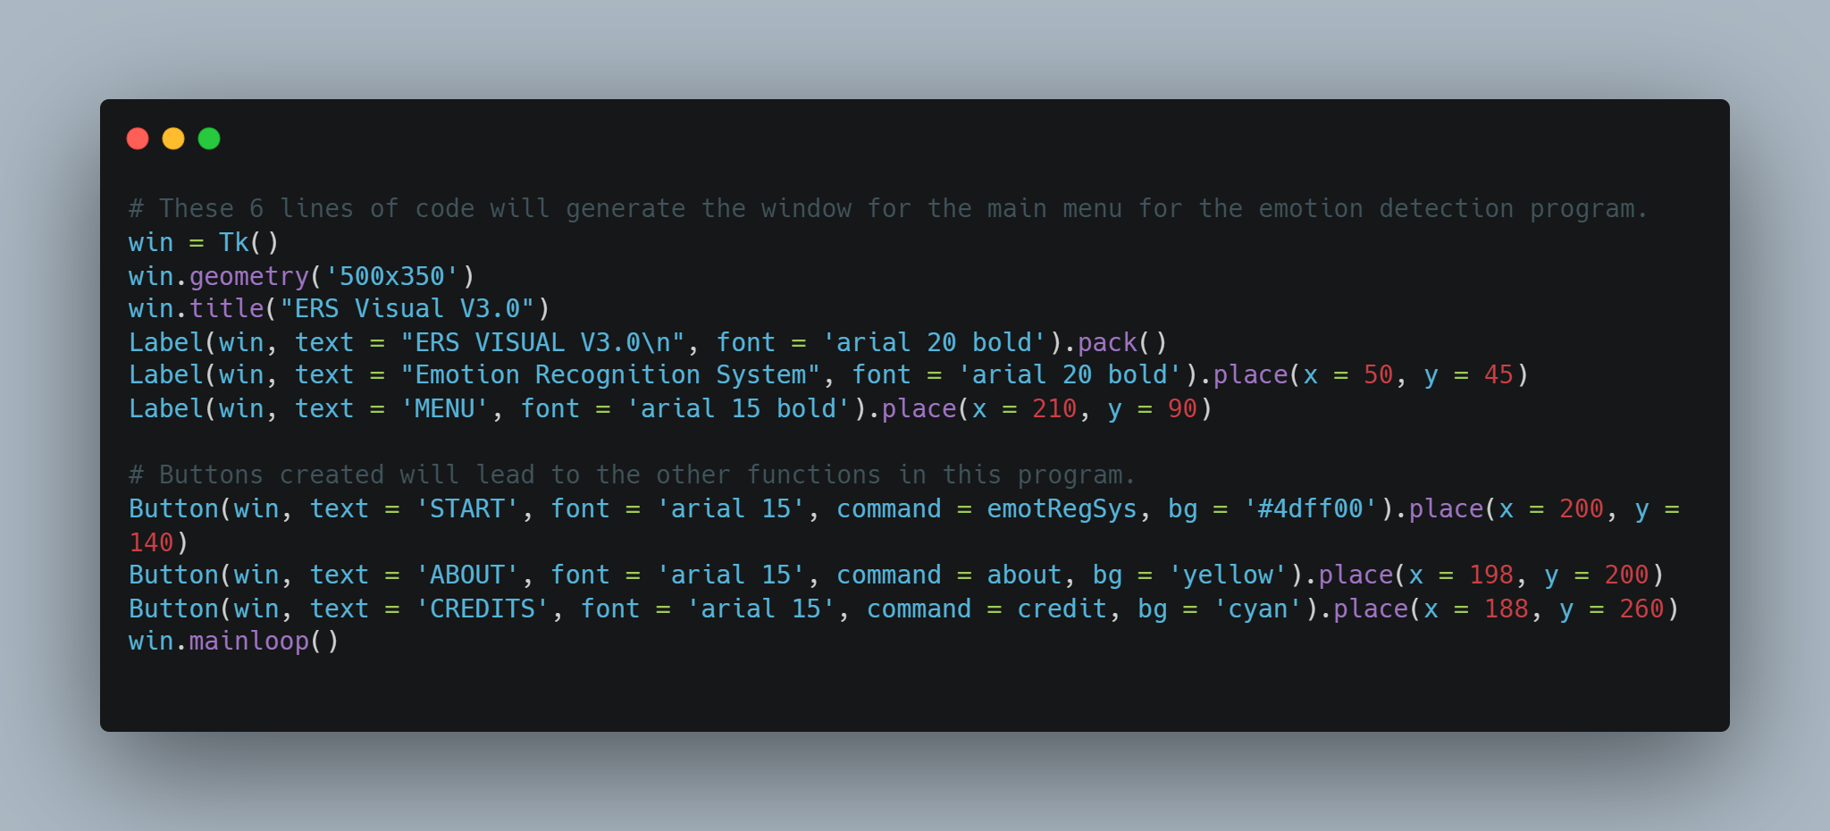
Creating the Main Menu of Program

Slide 13
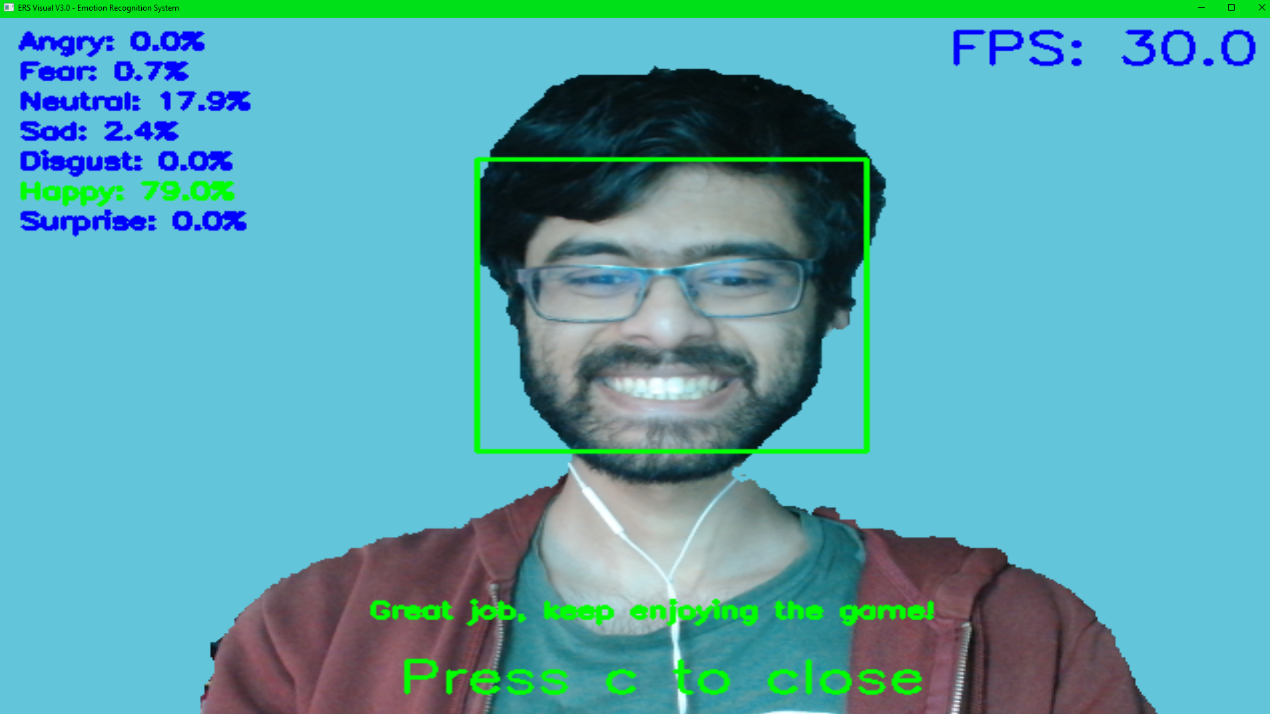
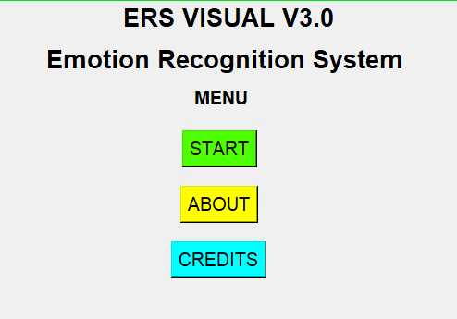

Visual Output and Game Choice for Experimentation

Slide 14
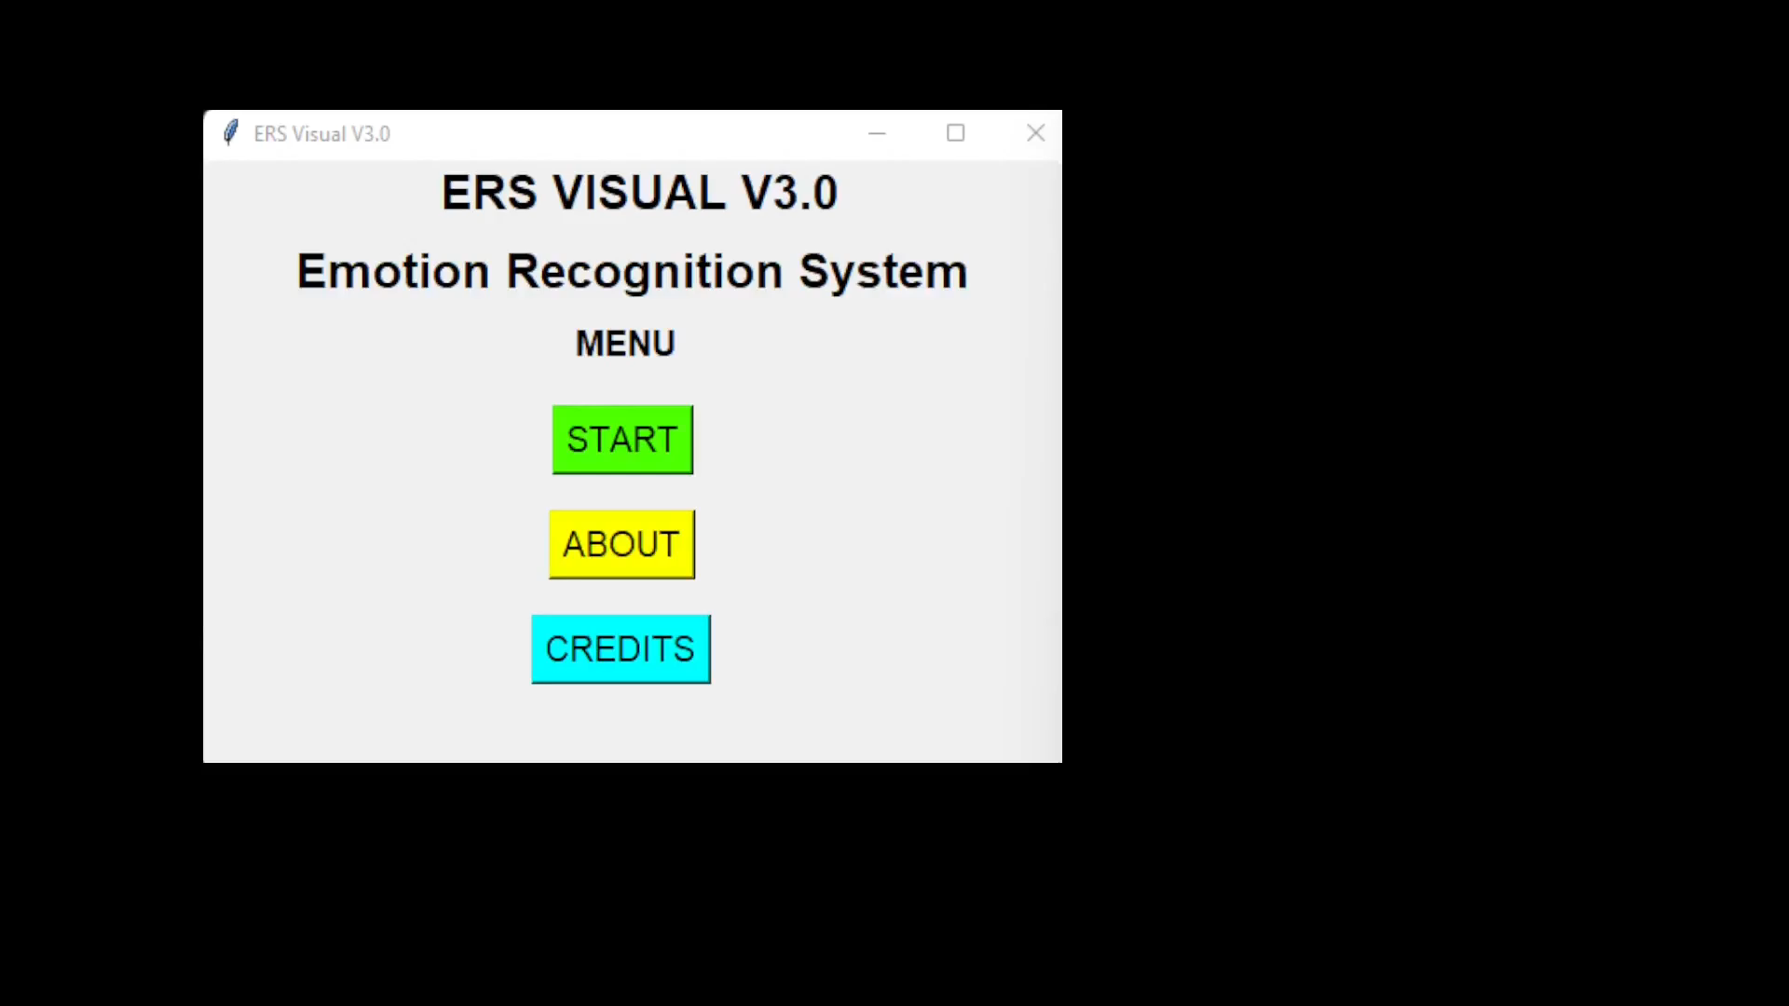
Demo
Please note that the demo video is short because the video is only meant to show what possible emotions could be detected during the gameplay.

Slide 15
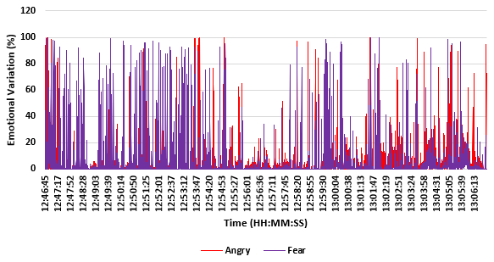
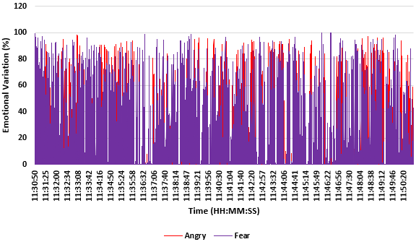
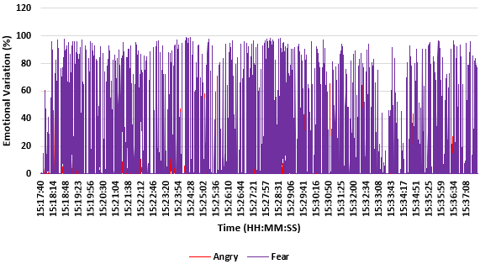
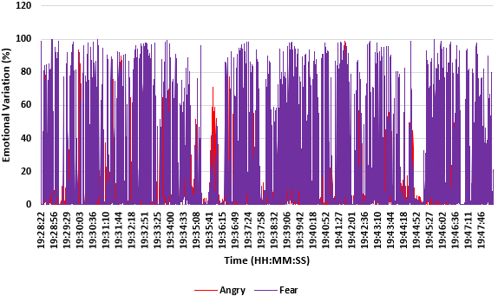
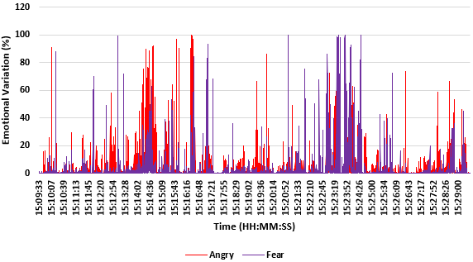
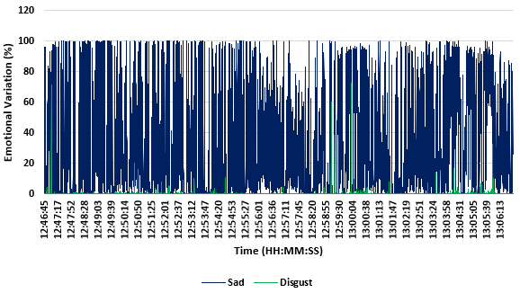
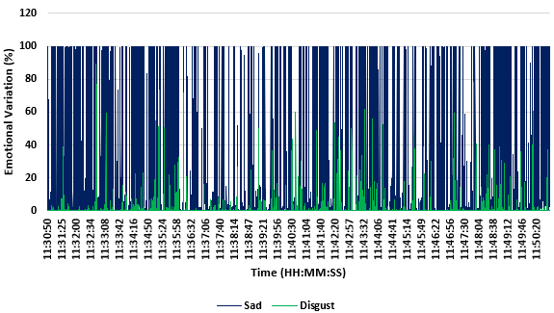
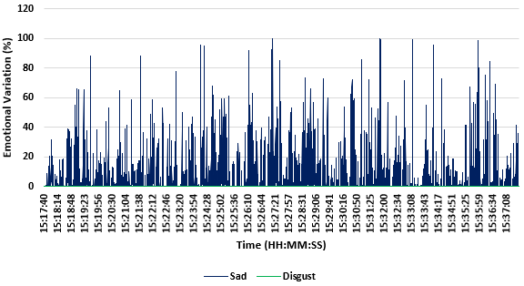
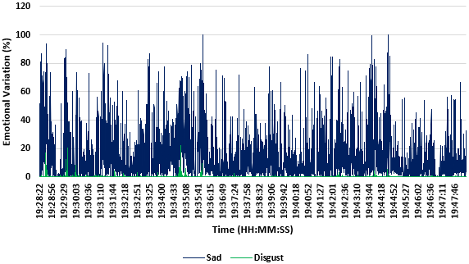
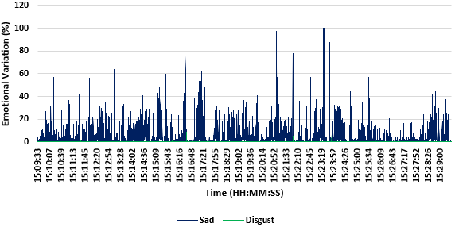
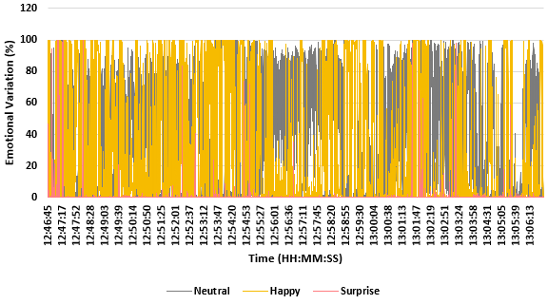
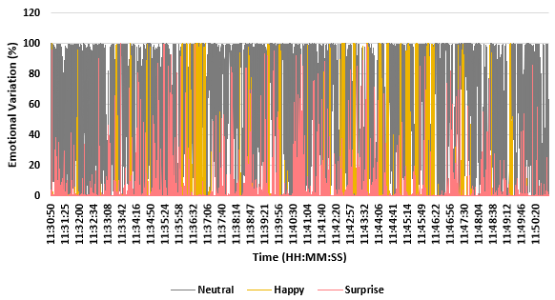
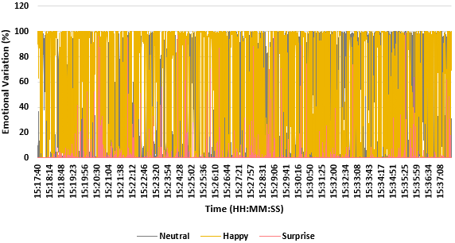
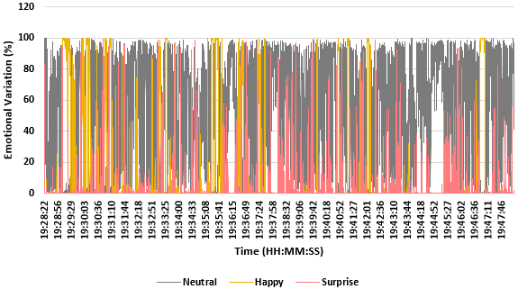
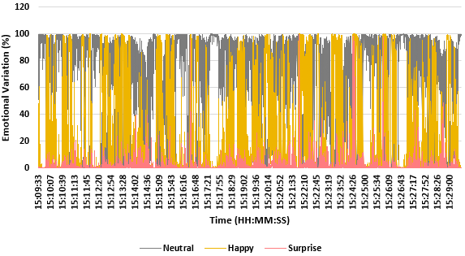
Experimentation Results (20 Minute Sessions)
Volunteer 1
Volunteer 2
Volunteer 3
Volunteer 4
Volunteer 5

Slide 16
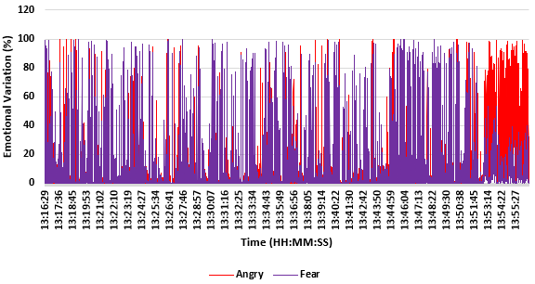
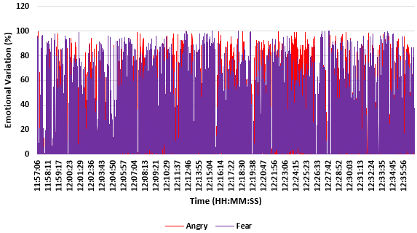
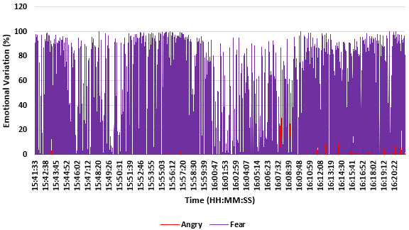
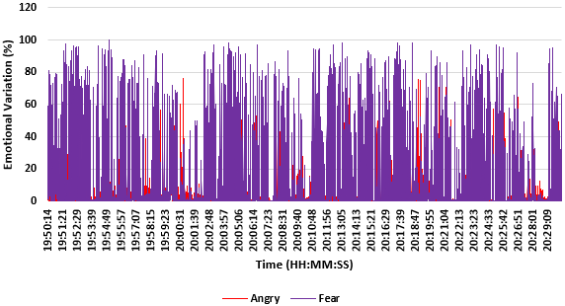
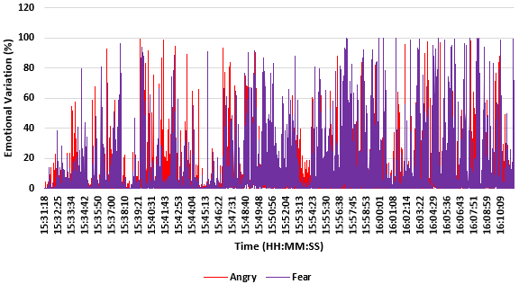
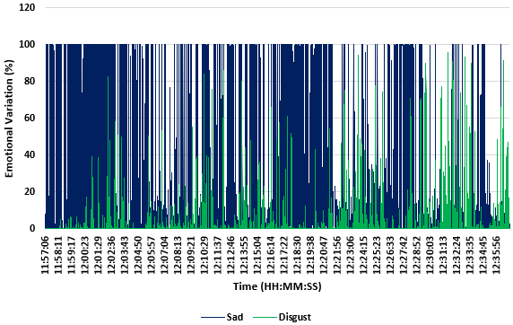
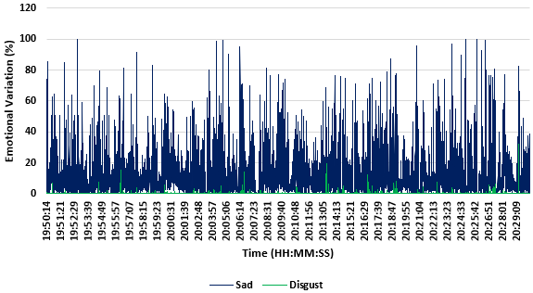
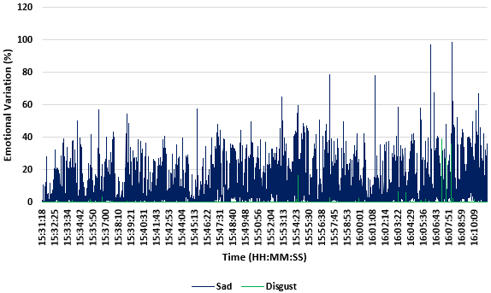
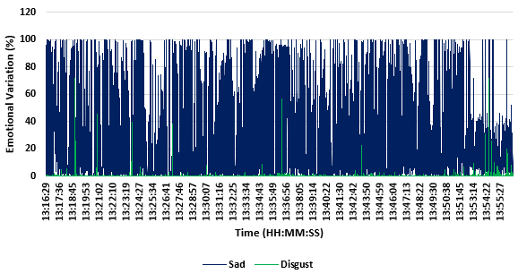
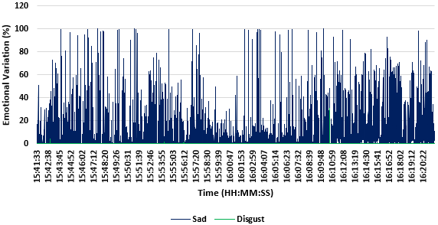
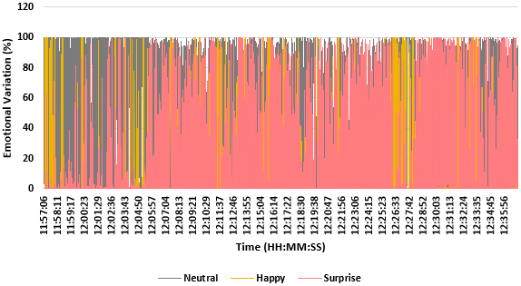
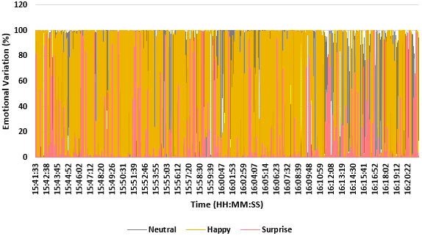
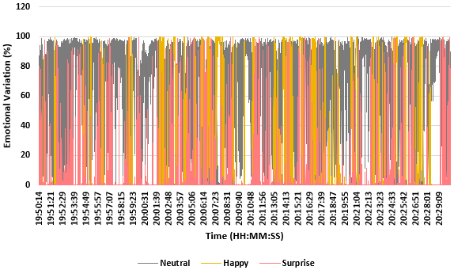
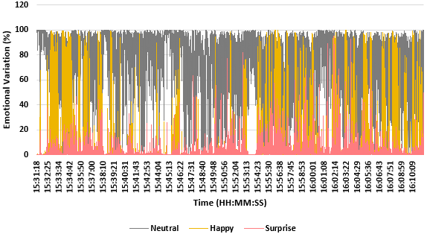
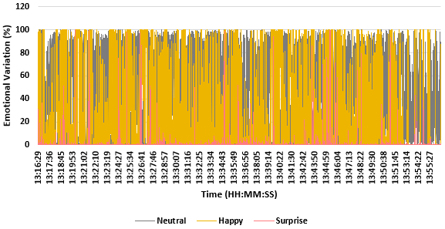
Experimentation Results (40 Minute Sessions)
Volunteer 1
Volunteer 2
Volunteer 3
Volunteer 4
Volunteer 5

Slide 17
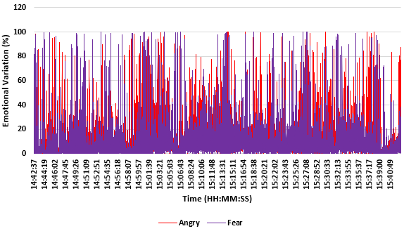
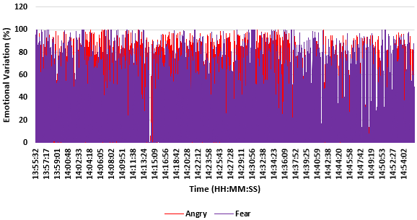
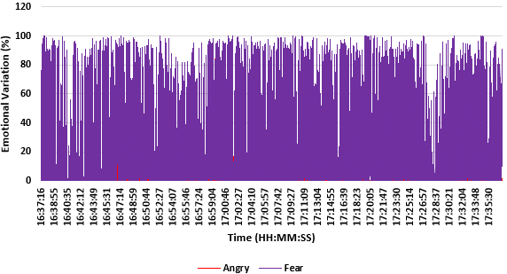
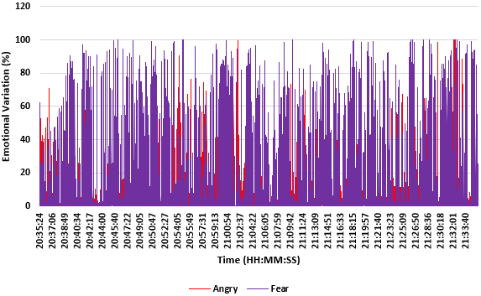
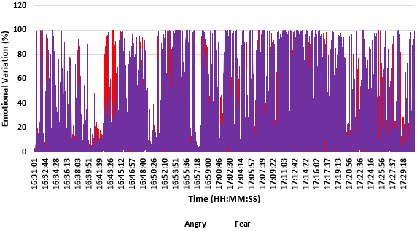
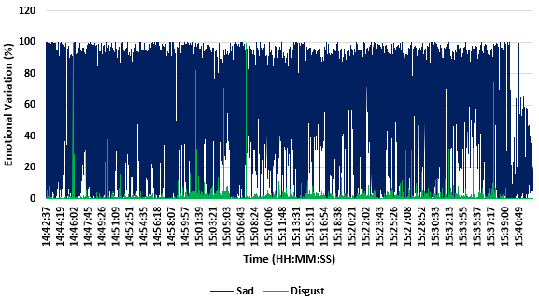
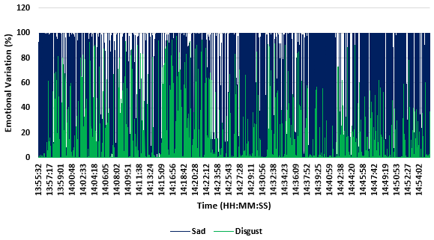
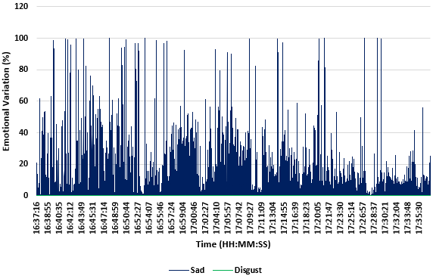
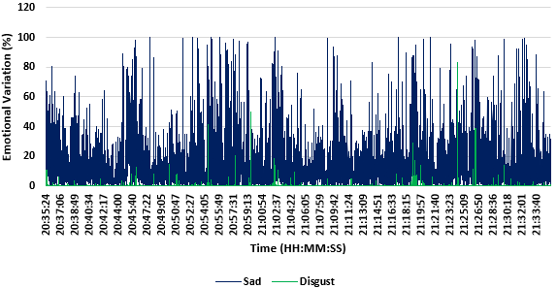
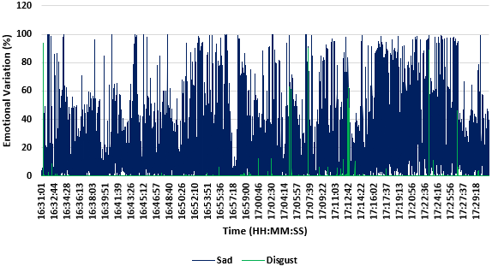
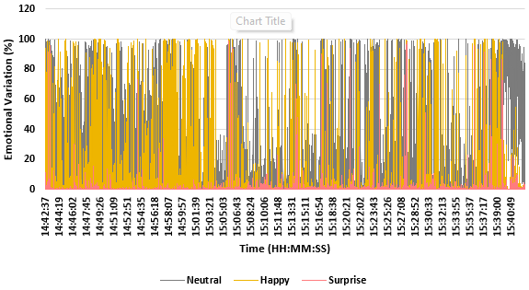
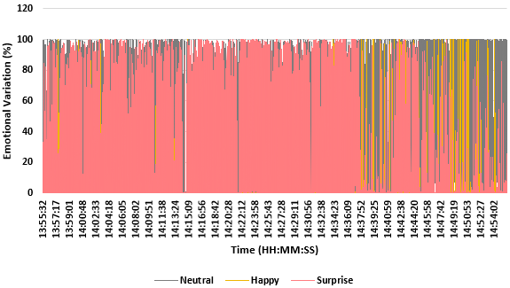



Experimentation Results (60 Minute Sessions)
Volunteer 1
Volunteer 2
Volunteer 3
Volunteer 4
Volunteer 5

Slide 18



Post Experimentation Reviews

Slide 19
Conclusion
Results showed an increase in the intensity of emotions experienced from 20 minute session to 60 minute session.
Based on the results and analysis of results, it can be concluded that longer gameplay has an impact on player’s emotions.
A significant increase seen in negative types of emotion (e.g. anger).

Slide 20
Conclusion
The findings of this project will help the game developers to make games that are more exciting to play, but have a shorter time frame.
The program was originally meant to be an application, but had issues in the conversion process as a result of errors I could not fix.
Doing this project has help me understand that games have a unique way of generating emotions based on the content created.
This change will reduce the emotional impact that is usually caused by playing video and computer games.
Finally, if I could do the experiment again, I would try this on a larger sample size to see if there would be any further impact.

Slide 21
THANK YOU FOR WATCHING!

